Slide 1
Advanced Software Engineering
Lecture 1: Introduction
Shehla Saeed
Notes:
“Welcome to our first lecture on Advanced Software Engineering. Today, we’ll start from the basics of engineering, move into software and software engineering, discuss processes, models, and why software sometimes fails spectacularly.”

Slide 2
What is Engineering?
- Application of science & math
- Design & build solutions
- Solve real-world problems
Notes:
“When you hear the word engineering, what comes to your mind—bridges, machines, robots, or maybe… software?”
Definition: Engineering is the application of scientific and mathematical principles to design and build systems that solve real-world problems.
Example:
Civil engineers build bridges that don’t fall; software engineers build systems that don’t crash (hopefully).

Slide 3
What is Software?
- Instructions + data for computers
- Types:
• System software (OS, drivers)
• Application software (apps)
• Embedded software (IoT, devices)
Notes:
“So, what exactly is software? Is it just the apps on your phone, or more?”
Definition: Software is a collection of programs, data, and instructions that tell a computer how to perform tasks.
Examples:
Microsoft Word (application software)
Windows/Linux (system software)
Database engines like MySQL
“Software is the invisible mind behind the machine. Without it, your phone is just a very expensive brick. Think of system software like the operating system, application software like WhatsApp, and embedded software like the program inside your automatic washing machine.”

Slide 4
What is Software Engineering?
- Systematic approach to software
- Combines engineering + computing
- Focus: reliability, scalability, maintainability
Notes:
“Why can’t we just write code and be done with it? Why complicate things with ‘software engineering’?” “Why do you think software engineering is needed instead of just ‘coding’?”
“Software engineering is about discipline. Anyone can write code.
But to build software for banks, hospitals, or governments, we need systems that are reliable, scalable, and maintainable. This is what software engineering ensures.”
Definition: Software Engineering is the disciplined, systematic approach to designing, developing, testing, and maintaining software.
Analogy: Building software is like building a skyscraper—you need blueprints, processes, and quality checks, not just a pile of bricks.
Example:
A banking system that handles millions of transactions daily requires engineering, not random coding.

Slide 5
Software Process
A framework that describes the activities performed at each stage of a software development project.
A set of activities whose goal is the development or evolution of software.
S/w process activities:
1. Requirements analysis
2. Design
3. Implementation
4. Testing
5. Deployment
6. Maintenance
Notes:
A framework that describes the activities performed at each stage of a software development project.
A set of activities whose goal is the development or evolution of software.

Slide 6
Plan-driven and agile processes
Plan-driven processes are processes where all of the process activities are planned in advance and progress is measured against this plan.
In agile processes, planning is incremental and it is easier to change the process to reflect changing customer requirements.
There are no right or wrong software processes.

Slide 7
Plan-driven process
Definition: A traditional, structured, and heavily documented approach to software development. Everything is planned upfront, and change is discouraged.
Characteristics:
Requirements defined early.
Detailed documentation at every stage.
Sequential phases (fits with Waterfall, V-model).
Strict timelines and budgets.
Strengths:
Works well for projects with stable, well-understood requirements.
Easier to manage in highly regulated industries (aerospace, defense, healthcare).
Weaknesses:
Inflexible—any change is costly.
Long delays before delivering working software.
Example: Developing software for an airplane control system. You cannot just “wing it.”
Notes:
Definition: A traditional, structured, and heavily documented approach to software development. Everything is planned upfront, and change is discouraged.
Characteristics:
Requirements defined early.
Detailed documentation at every stage.
Sequential phases (fits with Waterfall, V-model).
Strict timelines and budgets.
Strengths:
Works well for projects with stable, well-understood requirements.
Easier to manage in highly regulated industries (aerospace, defense, healthcare).
Weaknesses:
Inflexible—any change is costly.
Long delays before delivering working software.
Example: Developing software for an airplane control system. You cannot just “wing it.”

Slide 8
Agile process
Definition: An iterative and flexible approach that emphasizes collaboration, customer feedback, and working software over documentation.
Characteristics:
Requirements evolve over time.
Development is done in short iterations (sprints).
Continuous customer involvement.
Focus on delivering usable features quickly.
Strengths:
Adapts to changing requirements.
Early and frequent delivery of working software.
Encourages teamwork and communication.
Weaknesses:
Can lack documentation, which makes long-term maintenance tricky.
Harder to estimate cost and timeline upfront.
Example: Developing a mobile app startup product, where features shift based on user feedback.

Slide 9
Types of SDLC Models
Waterfall Model
Incremental Model
RAD Model
Spiral Model
Scrum Model
Lean Development Methodology
Extreme Programming

Slide 10
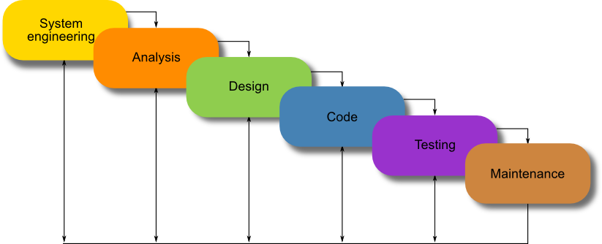
WATERFALL MODEL
.
Notes:
A sequential SDLC model where each phase must be completed before the next begins.
No overlapping phases
Clear documentation
Fixed requirements

Slide 11
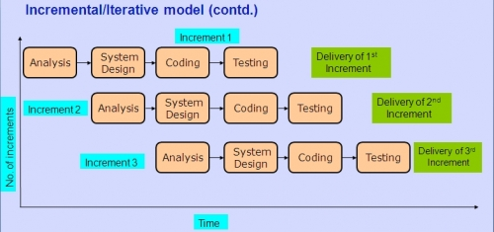
Incremental model
Notes:
A software development approach where the system is developed and delivered in multiple small releases, with each release adding new functionality.
Requirements divided into modules
Each increment goes through full SDLC cycle
Working product delivered early

Slide 12
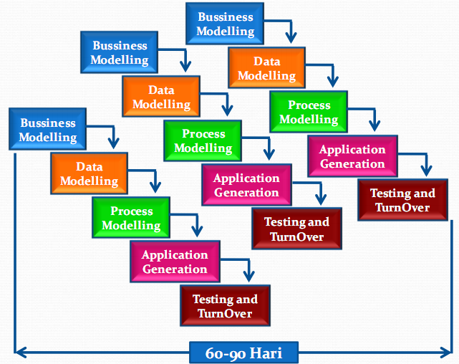
RAD model
Notes:
RAD is an SDLC model that emphasizes fast development, prototyping, and continuous user feedback to quickly produce high-quality software.
Iterative development
Active user participation
Fast delivery
Business Modelling
How the organization works
What information flows between departments
What the business goals are
Data Modelling
What data is needed
Database structure
Relationships between data (tables, entities)
Process Modelling
How data moves
What processes transform it
Workflows and logic
Application Generation
Rapid coding
Use of reusable components
Automatic code generation tools
RAD emphasizes speed. Developers often use frameworks, templates, or CASE tools.
Testing and Turnover
System testing
User acceptance testing
Deployment
User training
Then the next module starts — and the cycle repeats.

Slide 13
RAD model
The phases in the rapid application development (RAD) model are:
Business modeling: The information flow is identified between various business functions.
Data modeling: Information gathered from business modeling is used to define data objects that are needed for the business.
Process modeling: Data objects defined in data modeling are converted to achieve the business information flow to achieve some specific business objective. Description are identified and created for CRUD of data objects.
Application generation: Automated tools are used to convert process models into code and the actual system.
Testing and turnover: Test new components and all the interfaces.

Slide 14
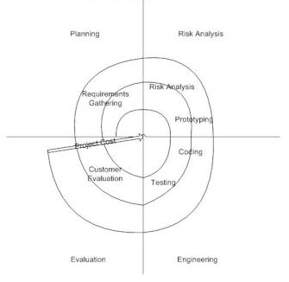
Spiral model
Notes:
The Spiral Model is a risk-driven software development model. It combines ideas from Waterfall (structured phases) and Iterative development (repetition), but adds one powerful ingredient:
Risk analysis at every cycle.
Think of it as building software in loops — and in every loop, you ask:“What could go wrong?”
Risk Analysis
Identify potential risks
Evaluate technical and cost risks
Develop prototypes to reduce uncertainty
This is the heart of the model.
When to Use Spiral Model
Large-scale projects
High-risk systems
New or complex technology
Mission-critical applications

Slide 15
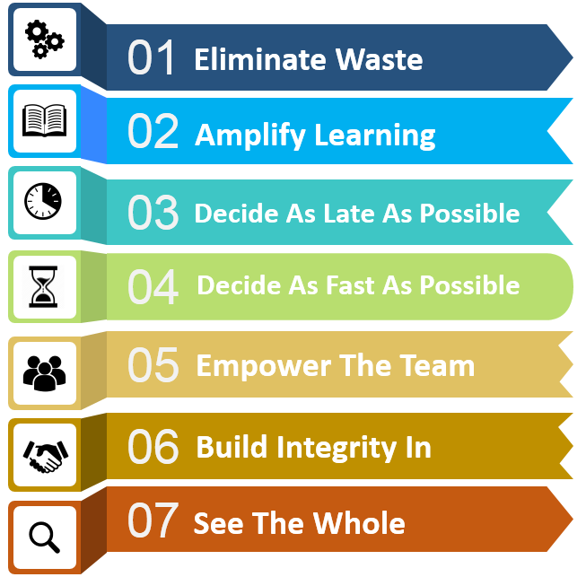
Lean Software Development
Deliver
Notes:
7 Principles of Lean Software Development.
Not exactly a step-by-step model like Waterfall or Spiral. This is more of a philosophy — a mindset borrowed from Lean manufacturing (Toyota Production System) and adapted to software.
Lean asks one uncomfortable question again and again:
“Are we doing something useful — or just staying busy?”
Waste in software is anything that does not add value to the customer.
Examples:
Unnecessary features
Excess documentation
Waiting time
Rework due to poor requirements
Lean says: If it doesn’t create value, remove it.

Slide 16
What are the attributes of good software?
A software product can be judged by what it offers and how well it can be used. This software must satisfy on the following grounds:
Operational
Transitional
Maintenance

Slide 17
Operational
This tells us how well software works in operations. It can be measured on:
Budget
Usability
Efficiency
Correctness
Functionality
Security
Safety

Slide 18
Transitional
This aspect is important when the software is moved from one platform to another:
Portability
Reusability
Adaptability

Slide 19
Maintenance
This aspect briefs about how well a software has the capabilities to maintain itself in the everchanging environment:
Modularity
Maintainability
Flexibility
Scalability

Slide 20
Reasons for Software Failure
- Poor requirements
- Unrealistic deadlines
- Lack of testing
- Scope creep
- Weak management
Notes:
“Why do software projects fail? Usually, it’s not coding errors—it’s poor planning, unclear requirements, and shifting goals

Slide 21
Key Challenges
- Managing complexity
- Rapidly changing requirements
- Security threats
- Balancing cost, time, quality
- Scaling to millions of users
Notes:
“Modern software faces huge challenges:
keeping up with changing needs, staying secure, and scaling.
Imagine the challenge Instagram faces when billions of people open the app daily.”

Slide 22
Closing Thought
- SE ≠ just coding
- Builds scalable, reliable, human-centered systems
Notes:
“Software engineering is about more than just programming.
It’s about designing systems that scale, adapt, and last. The failures you’ve seen in real life are proof of why software engineering matters.”

Slide 23
Lecture 2: SDLC Phases
Advanced Software Engineering
Shehla Saeed

Slide 24
Recap of Lecture 1
- What is Software Engineering?
- Software Process & SDLC overview
- Attributes of good software
- Reasons for software failure
Notes:
Interactive: Ask 2 students to summarize last lecture in 1 min each.

Slide 25
Introduction to SDLC
Definition: A framework of structured phases to develop, deploy, and maintain software.
Purpose:
- Ensures systematic development
- Reduces risks
- Improves quality and predictability
Notes:
Prompt: Why not just start coding immediately?

Slide 26
Phases of SDLC
- Requirement Engineering
- System Design
- Implementation (Coding)
- Testing
- Deployment
- Maintenance

Slide 27
Requirement Engineering
process of gathering, analyzing, and documenting requirements
Gather functional & non-functional requirements
- Techniques: Interviews, surveys, use cases
- Deliverable: Software Requirement Specification (SRS)
Challenges
Miscommunication between stakeholders and developers.
Changing requirements (“scope creep”).
Ambiguous or incomplete requirements.
Notes:
Requirement Analysis – Detailed Explanation
1. Definition
The process of gathering, analyzing, and documenting what the customer/user expects from the system.
Goal: Ensure developers build the right product.
2. Types of Requirements
Functional Requirements – what the system should do.
Example: “The system shall allow users to log in with a username and password.”
Non-Functional Requirements – qualities of the system.
Example: performance, security, usability, scalability.
3. Techniques for Gathering Requirements
Interviews with stakeholders.
Questionnaires/Surveys for large groups.
Workshops/Brainstorming sessions.
Observation of current systems in use.
Use Cases/User Stories to capture real scenarios.
4. Deliverables
SRS (Software Requirements Specification):
Document containing detailed requirements.
Includes scope, functional/non-functional requirements, assumptions, constraints.
Use Case Models & Diagrams: show how users interact with the system.
5. Challenges
Miscommunication between stakeholders and developers.
Changing requirements (“scope creep”).
Ambiguous or incomplete requirements.
6. Example for Class
If building a School Management System:
Functional: Student can view timetable, teacher can mark attendance.
Non-Functional: System should load a page within 2 seconds.
💡 Interactive Activity for Students:
list 2 functional and 2 non-functional requirements for a student learning portal.
Discuss which ones might be harder to implement and why.

Slide 28
System Design
- High-Level Design (architecture, modules)
- Low-Level Design (algorithms, database schema, UI)
- Tools: UML diagrams, ER models
Notes:
System Design – Detailed Explanation
1. High-Level Design (HLD)
Definition: Blueprint of the overall system, focusing on architecture and components.
Key Aspects:
System architecture (e.g., client-server, microservices, layered architecture).
Division of system into modules or subsystems.
Data flow between major components.
Technology stack selection (e.g., Java, Python, databases, cloud).
Deliverables: Architecture diagrams, module specifications.
Example: For an e-commerce app → modules like User Management, Product Catalog, Payment Gateway, Order Tracking.
2. Low-Level Design (LLD)
Definition: Detailed design at the component level, focusing on internal logic.
Key Aspects:
Class diagrams with attributes, methods, and relationships.
Database schema design (tables, keys, relationships).
API specifications (endpoints, inputs/outputs).
UI/UX layouts (wireframes, screen designs).
Deliverables: Class diagrams, ER models, pseudocode, detailed design documents.
Example: For "Login Module" → algorithm for authentication, database table structure for users, session management rules.
3. Tools for System Design
UML (Unified Modeling Language):
Use Case Diagram → shows user interactions.
Class Diagram → object-oriented design.
Sequence Diagram → flow of operations between components.
Activity Diagram → workflows.
ER (Entity-Relationship) Model:
Used for database design.
Entities, attributes, relationships (1:1, 1:N, M:N).
Ensures normalization and efficient database schema.
💡 How to make it interactive in class:
Show students a use case diagram for a "Library Management System."
Ask: “Which part belongs to HLD and which to LLD?”

Slide 29
Implementation (Coding)
- Translate design into working code
- Use coding standards, version control
- Tools& Technologies:
Programming languages
verion control: Git
IDEs :Eclipse ,VS code, pyCharm
CI/CD pipelines
Goal: Deliver working software modules that meet the design and requirements.
Notes:
Definition
The phase where design is translated into source code using programming languages, frameworks, and tools.
Goal: Deliver working software modules that meet the design and requirements.
2. Key Activities
Coding: Writing programs for each module/component.
Code Review: Peer review to maintain quality and consistency.
Integration: Combine modules into a single system.
Unit Testing: Test individual components during development.
Documentation: Code comments, developer guides, and API documentation.
3. Best Practices
Follow coding standards (naming conventions, indentation, comments).
Use version control (Git, GitHub, GitLab).
Apply modularity → break system into manageable components.
Continuous Integration (CI) → automatically test and build software.
Ensure error handling and exception management. CI/CD stands for Continuous Integration / Continuous Delivery (or Deployment).
4. Tools & Technologies
Programming Languages: Java, Python, C#, JavaScript, etc.
IDEs: IntelliJ, Eclipse, VS Code, PyCharm.
Version Control: Git, SVN.
CI/CD Pipelines: Jenkins, GitHub Actions, GitLab CI.
It’s a set of practices in software development that automates building, testing, and releasing code so teams can deliver updates faster and with fewer bugs.
Build Tools: Maven, Gradle, npm.
5. Deliverables
Source code for each module.
Executable files (after compilation/build).
Unit test results.
Developer documentation.
6. Example for Class
E-commerce App “Checkout Module”:
Code for calculating total price.
Integration with Payment Gateway API.
Unit test for verifying discount logic.
Activity: Role-play coder vs tester to show unclear design errors.

Slide 30
Testing
- Unit Testing → components
- Integration Testing → modules
- System Testing → entire system
- Acceptance Testing → customer validation
Notes:
Objective: Ensure the software works as intended, meets requirements, and is free of major defects.
1. Levels of Testing
Unit Testing
Tests individual components (functions, classes, modules).
Example: Checkout module → “ApplyDiscount()” function tested separately.
Integration Testing
Tests interaction between modules.
Example: Checkout + Payment Gateway work correctly together.
System Testing
Tests the entire application as a whole.
Example: Full e-commerce workflow → search → add to cart → checkout → payment.
Acceptance Testing (UAT)
Performed by end-users or clients to check if requirements are met.
Example: Customer verifies that the app correctly applies discount codes.
2. Types of Testing
Functional Testing: Validates features (login, checkout).
Non-Functional Testing: Checks performance, security, usability.
Regression Testing: Ensures new changes don’t break old features.
Smoke Testing: Quick test to see if the build is stable enough for further testing.
3. Example for Students
👉 E-commerce Checkout Module
Unit test: Verify discount logic.
Integration test: Payment Gateway API processes correct amount.
System test: Place an order end-to-end.
Acceptance test: Client checks if UI and workflow match requirements.
4. Tools for Testing
JUnit, NUnit → Unit testing
Selenium → Automated UI testing
Postman → API testing
JMeter → Performance testing
💡 Class Activity Question: “If a bug is found during system testing, should it be fixed immediately, or logged and prioritized? Why?”
Interactive Poll: Release early with bugs or late but stable?

Slide 31
Question:
👉 “If you were leading a software project, would you prefer to release the product early (with some known bugs) or release it late but fully stable?”
Notes:
Option A: Release Early (with some bugs)
✅ Users get new features quickly.
✅ Faster market feedback.
❌ Risk of damaging reputation.
❌ More maintenance patches later.
Option B: Release Late (stable)
✅ Higher quality, fewer bugs.
✅ Builds trust with customers.
❌ Slower time-to-market.
❌ May miss competitive opportunities.
Conclude with:
Agile companies (like Facebook, Google) often release early and patch later.
Critical systems (like banking, medical software) must release stable.
💡 Teacher Tip: Tie this back to CI/CD Pipelines → companies can release early because pipelines ensure bugs are caught and patched quickly.

Slide 32
Deployment
- Deliver software to users
- Strategies:
* Direct Cutover: quick but risky
* Parallel Running: safe but expensive
* Phased Rollout: gradual, lower risk
- Deliverables: Installed software, manuals, training
Scenario: Which strategy is safest for hospital software?
Notes:
Core Idea
Deployment is the process of releasing the developed and tested software into the production environment so end-users can use it.
Key Points to Explain
Definition:
Deployment = delivering the software to actual users.
Involves setup, configuration, data migration, and training.
Strategies for Deployment:
Direct Cutover (Big Bang):
Old system is stopped, new system is started immediately.
Advantage: Quick and simple.
Disadvantage: High risk – if it fails, no backup.
Parallel Running:
Old and new systems run together for some time.
Advantage: Safe, easy to compare results.
Disadvantage: Expensive, time-consuming.
Phased Rollout:
New system is deployed in stages (e.g., one module or one branch at a time).
Advantage: Lower risk, gradual adoption.
Disadvantage: Longer implementation time.
Deliverables:
Installed software
User manuals
Training sessions
Post-deployment support plan
Interactive Activity for Students
Scenario Question:
“Imagine we are deploying a hospital management system. Which strategy would you choose and why?”
Students should weigh risks (critical system = patient safety) vs. cost/time.
Expected Responses:
Parallel running or phased rollout are safer than direct cutover.
Visual Suggestion for Slide 8
A comparison table of the three strategies with pros & cons.
Or an infographic showing three paths branching from “Deployment.”

Slide 33
Maintenance
- Activities after deployment
- Types:
* Corrective: Fix errors
* Adaptive: Adjust to new environments
* Perfective: Improve features/performance
* Preventive: Avoid future risks
Notes:
Prompt: Which apps on your phone get frequent updates?

Slide 34
Software Evolution
- Software must evolve or it becomes obsolete
- Lehman’s Laws: systems adapt or die
- Examples: Windows OS, WhatsApp, Android versions
Notes:
Interactive Q: What if WhatsApp never updated after release?
Lehman’s Laws: “Systems adapt or die”
Core Idea:
Software is never “done.”
If it doesn’t evolve → it becomes obsolete.
Changing needs, hardware, users, and competition force software to adapt.
Examples for Class
Windows OS
Windows 95 → XP → 7 → 10 → 11.
Microsoft keeps updating because hardware, user needs, and security threats evolve.
If Windows stopped updating after XP, it would have “died” in the market.
WhatsApp
Started as simple messaging.
Evolved to voice calls, video calls, WhatsApp Web, disappearing messages, payments.
Without adapting, it would have lost users to Telegram or Signal.
Android Versions
Cupcake → KitKat → Lollipop → Oreo → Android 14+.
Each release adapts to new mobile hardware (foldable phones, 5G) and security needs.
If Android didn’t evolve, Apple iOS would dominate completely.
Interactive Question for Students
👉 “Can you think of an app or system you stopped using because it didn’t evolve?” (Expected answers: Orkut, Yahoo Messenger, Windows Phone, etc.)
💡 Teacher Tip: End with the takeaway — “Adaptation is survival in software. If a system doesn’t evolve, it dies.”

Slide 35
Summary
- SDLC = structured software development approach
- Each phase produces deliverables
- Maintenance & evolution are integral, not optional
- Software is a living product

Slide 36
Quick Quiz
1. Which SDLC phase defines 'what' the system should do?
2. Which phase ensures the system works correctly?
3. Maintenance is optional (T/F).
4. Deployment can happen in phases (T/F).

Slide 37
Requirement Engineering
Advanced Software Engineering
Ms. Shehla Saeed

Slide 38
What is Requirement Engineering?
Requirement Engineering (RE) is the process of discovering, documenting, and maintaining what users need and expect from a software system.
It focuses on understanding problems before writing code.

Slide 39
Why Requirements Matter
Around 70% of software projects fail due to unclear or changing requirements.
Proper RE reduces cost and improves customer satisfaction.
Question: Why do you think most projects fail?

Slide 40
Types of Requirements
User Requirements – What users expect (natural language)
Example: “App should let me book a ride.”
System Requirements – Technical details of what the system must do
Example: “System shall store booking data in a database.”
Domain Requirements – Constraints or rules that come from the application domain or environment
Example: “Booking records must comply with city transport authority regulations.”
Notes:
Normal requirements: These requirements are the objectives and goals stated for a product or system during meetings with the customer
Expected requirements: These requirements are understood to the product or system and may be so fundamental that the customer does not explicitly state them
Exciting requirements: These requirements are for features that go beyond the customer's expectations and prove to be very satisfying when present

Slide 41
Functional vs Non-Functional Requirements
Functional: Define what the system does.
Example: 'User can reset password.'
Non-Functional: Define system quality.
Example: 'Response time < 2 seconds.'
Quick Quiz: Which type is ‘System uptime 99.9%’?
Notes:
✅ That’s a Non-Functional Requirement (NFR) — specifically a Reliability / Availability requirement.
It describes how well the system performs (uptime), not what it does.

Slide 42
Functional vs Non-Functional Requirementss
Type | Description | Example
Functional | Define what the system should do | “System shall allow login and password reset.”
Non-Functional | Define quality attributes (how the system performs) | “System response time must be under 2 seconds.”

Slide 43
Common Problems in RE
Ambiguity: vague terms like 'fast' or 'easy'
Changing requirements (scope creep)
Conflicts among stakeholders
Lack of documentation
Activity: Client says 'Make it fast' — what would you ask next?

Slide 44
🎭 Roleplay Activity: 'Make It Fast!'
Client says: 'Make it fast.'
💬 Analyst should ask questions like:
What exactly do you mean by 'fast'?
Do you mean system response time or user task speed?
How many users will use the system simultaneously?
What’s an acceptable response time (1s, 3s, etc.)?
🎓 Lesson:
Ambiguous requirements cause confusion — clear, measurable ones ensure project success.
Notes:
🧩 Objective:
Show how vague requirements can be clarified.
Why was the original requirement unclear?” “How did better questioning improve the requirement?”

Slide 45
7 Phases of Requirement Engineering
Inception
Elicitation
Elaboration
Negotiation
Specification
Validation
Requirements
Management

Slide 46
7 Phases of Requirement Engineering
1. Inception – Identify goals & stakeholders
2. Elicitation – Gather requirements
3. Elaboration – Analyze & refine
4. Negotiation – Resolve conflicts
5. Specification – Document formally
6. Validation – Ensure correctness
7. Management – Handle changes

Slide 47
Requirement Elicitation Techniques
Interviews
Questionnaires
Observation
Brainstorming
Prototyping
Workshops (JAD)
Poll: Which method works best for a university management system?
Notes:
Brainstorming is another requirement elicitation technique used to generate a wide range of ideas or solutions in a short time.
💡 Key Features:
Group activity: Involves stakeholders, developers, and users.
Goal: Collect as many ideas as possible — no criticism allowed initially.
Focus: Creativity first, evaluation later.
Helps: Discover new features, identify problems, or refine system goals.
Steps:
Define the problem or topic clearly.
Encourage free flow of ideas — everyone contributes.
Record all ideas (whiteboard, sticky notes, or tools).
After idea generation, analyze and prioritize them.
Prototyping
To help users and developers understand requirements better by seeing a visual or functional mock-up of the system.
Steps in Prototyping
Gather initial requirements
Build a prototype (UI mock-up or basic working model)
Show it to users and gather feedback
Refine the prototype based on feedback
Repeat until requirements are clear and approved
JAD stands for Joint Application Development.
It’s a requirement elicitation technique used in software engineering where:
Developers, users, and stakeholders work together in structured workshops
The goal is to gather and refine system requirements quickly and clearly
🧠 Key points:
Conducted by a facilitator
Promotes collaboration and consensus
Produces detailed, well-understood requirements
Saves time compared to long interview cycles
Example: During a JAD session for a library system, librarians, IT staff, and students discuss features like book search, borrowing limits, and reminders — all in one interactive session.

Slide 48
Software Requirement Specification (SRS)
A formal document listing all functional and non-functional requirements.
Includes:
System overview
Use cases
Constraints & assumptions
Notes:
📘 Activity: Identify one functional & one non-functional requirement in a sample SRS.

Slide 49
Quick Recap Quiz
What is the goal of RE?
Give one functional & one non-functional requirement.
Why do requirements change?
What is SRS?

Slide 50
Case Study — Careem’s Super App (Pakistan)
Founded in 2015 as a ride-hailing app.
Later aimed to become a 'Super App' offering: Rides, Food, Grocery, Digital Wallet, Parcel Delivery.
Ambition: One app for everything.
Notes:
Class Discussion: How many of you have used Careem? Which service did you use most?

Slide 51
What Happened
2020–2021: Launch of Super App with multiple features.
2022: Shut down Careem Food in Pakistan (low profit).
2023–2024: Withdrew digital wallet license.
2024--2025: Only ride-hailing and parcel delivery active.
2026: Careem stopped its ride-hailing operations in Pakistan on 18 July 2025
Result: Multiple services failed — super app vision scaled back.
Notes:
no Careem cars, bikes, or ride bookings are available in Lahore anymore.
The company cited economic challenges, strong competition, and investment constraints as the main reasons for shutting down this service.

Slide 52
Problems Faced
Weak requirement alignment with market conditions.
Overly ambitious scope (too many services too fast).
Regulatory challenges for digital payments.
Low user adoption for food/grocery services.
Poor management of changing requirements.
Notes:
Ask: Was this a technical failure or a requirement failure?

Slide 53
Requirement Engineering Analysis
Inception: Vision too broad — not validated against market realities → Over-scoped.
Elicitation: User needs for non-core services not researched → Low adoption.
Elaboration: Risks, regulations underestimated → High costs.
Negotiation: Tried to do everything → Resource dilution.
Specification: Weak documentation of non-functional needs → Compliance issues.
Validation: Released before full local testing → Failures.
Management: Frequent change requests, shutdowns → Low stakeholder trust.

Slide 54
Key Requirement Engineering Lessons
Start with focused scope validated by real users.
Perform regulatory and market analysis early.
Define non-functional requirements clearly (security, usability).
Manage changing requirements systematically.
Align business goals with user needs.
Question: If you were on Careem’s RE team, which phase would you improve first — and how?

Slide 55
Discussion Poll
What was the MAIN reason the Super App failed in Pakistan?
A. Poor user requirement analysis
B. Weak regulatory understanding
C. Overly broad project scope
D. All of the above

Slide 56
Takeaway
Even successful companies can fail if requirements are unclear, unrealistic, or poorly managed.
Requirement Engineering is not just about documentation — it's about making the right choices at the right time.

Slide 57
Requirement Engineering Phases : (Case Study : Smart Parking System)
Ms. Shehla Saeed
Notes:
Introduction to the early phases of RE where analysts work to identify stakeholders and collect the right requirements for system success.

Slide 58
Lecture Overview
Requirements Engineering (RE)
Traditional RE phases
UML-based RE phases
Difference b/w the two approaches
Apply RE phases to a Smart Parking System

Slide 59
What is Requirement Engineering?
Requirements Engineering is the process of discovering, analyzing, documenting, validating, and managing system requirements.
Goal:
Ensure the software system meets stakeholder needs and solves the real problem.
Notes:
Requirement Engineering (RE) forms the foundation of all software projects. Each phase builds upon the previous one to ensure system correctness.

Slide 60
Traditional Requirements Engineering Phases
Traditional RE generally includes:
Requirements Elicitation
Requirements Analysis
Requirements Specification
Requirements Validation
Requirements Management
Mostly document-driven approach.

Slide 61
Traditional approach problems:
Heavy documentation(textual SRS)
Difficult stakeholder understanding
Limited visualization of system behavior
This led to the rise of model-based approaches using UML.

Slide 62
Difference b/w the 2 approaches
Traditional RE is like writing a detailed description of a city.
UML-based RE is like drawing the city map showing roads, buildings, and how people move between them.
Both describe the same city, but the second one lets people see the structure instantly.

Slide 63
UML-Based RE Phases
UML-based RE includes:
Inception
Elicitation
Elaboration
Negotiation
Specification
Validation
Requirements Management

Slide 64
Phase 1: Inception
Objectives:
Understand problem domain
Identify key stakeholders
Define project scope and goals
Activities:
Identify stakeholders
Define the system purpose
Understand the problem environment
Establish project feasibility
Notes:
Inception is the 'getting started' phase. The main purpose is to define what problem we are solving, who is involved, and whether it’s feasible to proceed.

Slide 65
Example: Smart Parking System (Inception)
Problem: Drivers cannot easily locate available parking spaces, traffic congestion.
Goal: Develop a system that provides real-time parking information through a mobile application.
Scope: The Smart Parking System will include:
Real-time parking space detection, Mobile application for drivers, Parking reservation system, Online payment system, Notifications and alerts, Parking management dashboard
Out of Scope: The system will NOT include:
Physical parking construction, Traffic signal management, Law enforcement automation.
Notes:
This example illustrates how inception helps define the vision and boundaries before development starts.
Scope defines what the system will do and what it will NOT do

Slide 66
Feasibility Assessment
Budget Feasibility (Economic Feasibility)
Time Feasibility (Schedule Feasibility)
Business Feasibility
Potential benefits
Possible Revenue sources
Technical Feasibility
whether the technology exists to implement the system.
Notes:
Budget feasibility determines whether the organization can afford to develop and maintain the system. It compares estimated project cost with available budget.
Time feasibility evaluates whether the system can be developed and implemented within the required time frame.
Potential Benefits
Reduced traffic congestion
Improved parking revenue
Efficient parking management
Better driver experience
Possible Revenue Sources
Parking fees
Reservation charges
Premium parking services
Advertising in mobile app
Required Technologies
Parking Sensors Detect vehicle presence.
Mobile Application Android / iOS interface for drivers.
Cloud Server Stores parking data.
GPS Integration Provides navigation.
Payment Gateway Supports digital transactions.

Slide 67
Stakeholder Identification
Primary Stakeholders
Stakeholder | Role
Drivers | Use mobile app to find parking
Parking Authority | Manage parking infrastructure
City Administration | Monitor traffic and parking utilization
Parking Attendants | Assist drivers and maintain parking areas
System Administrators | Maintain system operations
External Stakeholders
Stakeholder | Role
Payment Gateway Providers | Process digital payments
Mobile Network Providers | Provide internet connectivity
Hardware Vendors | Provide parking sensors and cameras

Slide 68
Initial System Features
During inception, only high-level features are identified.
Major System Features
Real-Time Parking Availability : Sensors detect whether parking spots are occupied.
Parking Search: Drivers can search nearby parking areas.
Parking Reservation: Drivers can reserve a spot before arrival.
Navigation Support: Drivers receive directions to the parking spot.
Online Payment: Digital payment via mobile app.
Parking Notifications: Alerts for reservation confirmation and parking expiration.
Admin Dashboard: Parking authorities can monitor occupancy and revenue.
Notes:
High level Use case diagrams

Slide 69
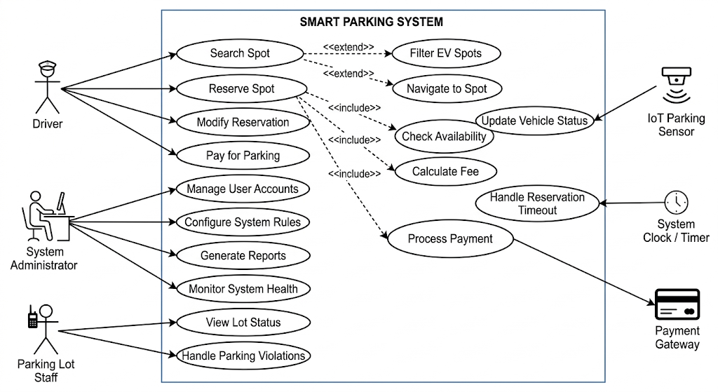

Slide 70
Risk Identification
Early risks are identified during inception.
Possible Risks
Sensor failure leading to incorrect parking data
Poor internet connectivity
User resistance to new technology
Security risks in online payment systems
Early risk identification allows teams to prepare mitigation strategies later.

Slide 71
Phase 2: Elicitation
Objective: Gather detailed requirements from stakeholders
Techniques:
Interviews
Questionnaires
Observation
Workshops
Prototyping
Use cases
.
Notes:
Elicitation focuses on communication. Analysts use multiple methods to ensure that real user needs are captured and understood.

Slide 72
Challenges in Elicitation
Stakeholders unsure of what they want
Conflicting needs
Communication barriers
Changing requirements
Notes:
Discuss how analysts overcome these issues using iterative meetings, prototypes, and good documentation practices.

Slide 73
Elicitation Results (Smart Parking)
Findings from stakeholder discussions:
Drivers need:
Real-time parking availability
Navigation to available parking
Online payment option
Parking authorities need:
Parking usage reports
Monitoring of parking occupancy
Revenue tracking
Notes:
Detailed Use case diagrams

Slide 74
Phase 3: Elaboration
Elaboration refines the collected requirements and develops detailed requirement models using UML.
Activities include:
Developing use case models
Identifying system actors
Defining system interactions
Understanding functional workflows
Goal
Transform raw requirements into structured system models.
Notes:
Activity Diagrams: map the step-by-step workflow of a driver booking a spot and navigating to it.
Conceptual Class Diagrams: build a domain dictionary. define that a Reservation class must be linked to a User class and a ParkingSpot clas

Slide 75
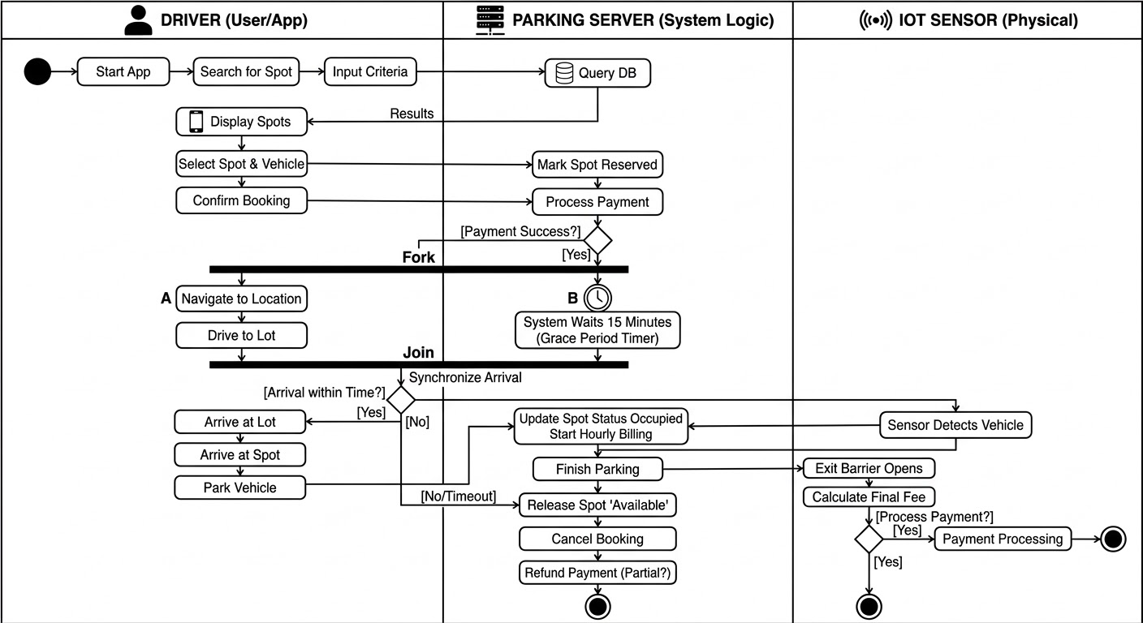

Slide 76
Use Case Model for Smart Parking
Actors
Driver, Parking Admin, System
Main Use Cases
Driver:
Search parking, Reserve parking space, Make payment, Receive notifications
Admin:
Manage parking spaces, Monitor parking usage, Generate reports
Use case diagrams help visualize how users interact with the system.
Notes:
Use case diagrams help visualize how users interact with the system.

Slide 77
Phase 4: Negotiation
Sometimes stakeholder requirements conflict with each other.
Negotiation resolves these conflicts.
Example Conflict
Drivers want long reservation times.
Parking authority fears spaces will remain unused.
Solution
Introduce limited reservation duration (e.g., 10 minutes).
This ensures fairness and efficient space usage.
Notes:
State Machine Diagrams. model the lifecycle of a parking spot to explicitly agree on the rules.
define states: Available →Reserved.
If the sensor doesn't detect a car in 15 minutes, it transitions back to Available (the negotiated rule).

Slide 78
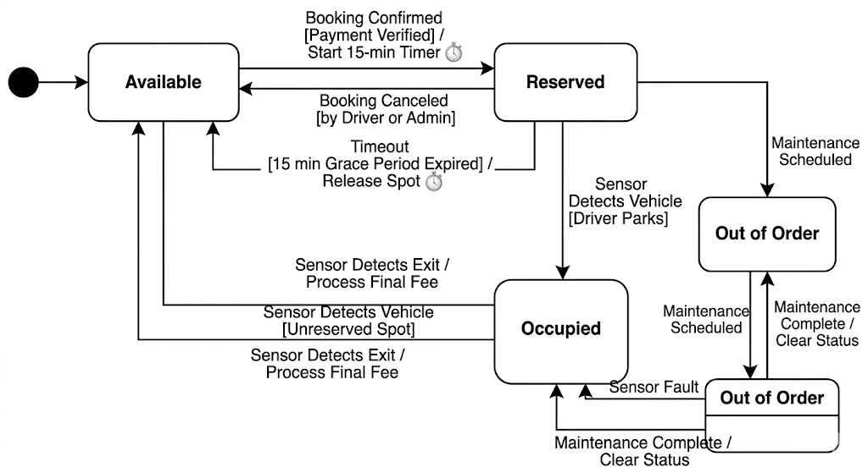

Slide 79
Phase 5: Requirements Specification
Specification documents requirements in a Software Requirement Specification (SRS).
Two main types:
Functional Requirements: Describe system behavior.
System shall display available parking spots.
System shall allow drivers to reserve a slot.
System shall process online payments
Notes:
Sequence Diagrams.
map out the exact message passing over time.

Slide 80
Non-Functional Requirements
Performance Parking updates should occur within 3 seconds.
Security Payment transactions must be encrypted.
Usability Users should locate parking within 3 clicks.

Slide 81
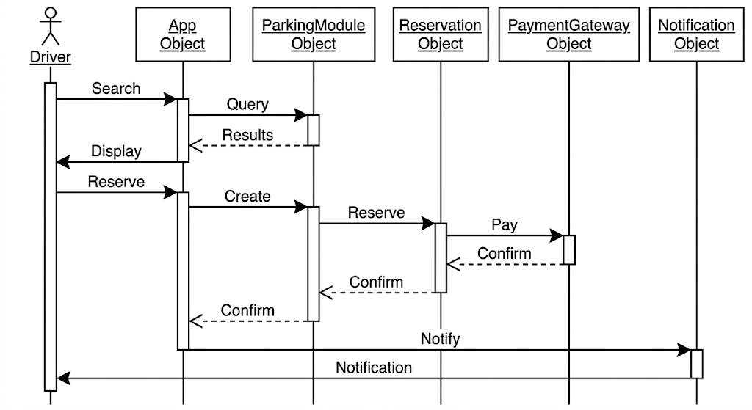
Notes:
For example: Mobile App requests reservation → Parking Server locks the spot in the database →Server sends a success payload back to the App.

Slide 82
Phase 6: Requirements Validation
Validation ensures requirements are:
Correct, Complete, Consistent, Feasible
Validation Techniques
Requirement reviews
Prototyping
Stakeholder meetings
Test case development
Example:
A prototype parking mobile app interface is shown to drivers for feedback.

Slide 83
Phase 7: Requirements Management
Requirements change during development.
Management ensures changes are tracked and controlled.
Activities include:
Change request management
Requirement version control
Traceability tracking
Example Change
City authorities request EV charging parking spots to be integrated into the system.
Notes:
EV chargers

Slide 84
Requirement Traceability Example
Traceability connects requirements with design and testing.
Example
Requirement: Driver can reserve parking slot
Linked to
Use Case: Reserve Parking
Module: Reservation System
Test Case: Parking Reservation Test
Traceability ensures every requirement is implemented and tested.

Slide 85
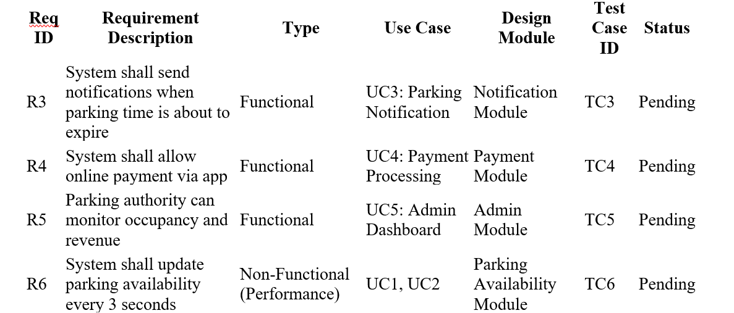
Traceability matrix (Smart Parking System)
Notes:
Req ID: Unique identifier for each requirement.
Requirement Description: Clearly describes what the system must do.
Type: Functional or Non-Functional requirement.
Use Case: Links requirement to one or more UML use cases.
Design Module: The system component or module implementing this requirement.
Test Case ID: Corresponding test case to verify the requirement.
Status: Can be Pending, Implemented, Verified, or Updated.

Slide 86
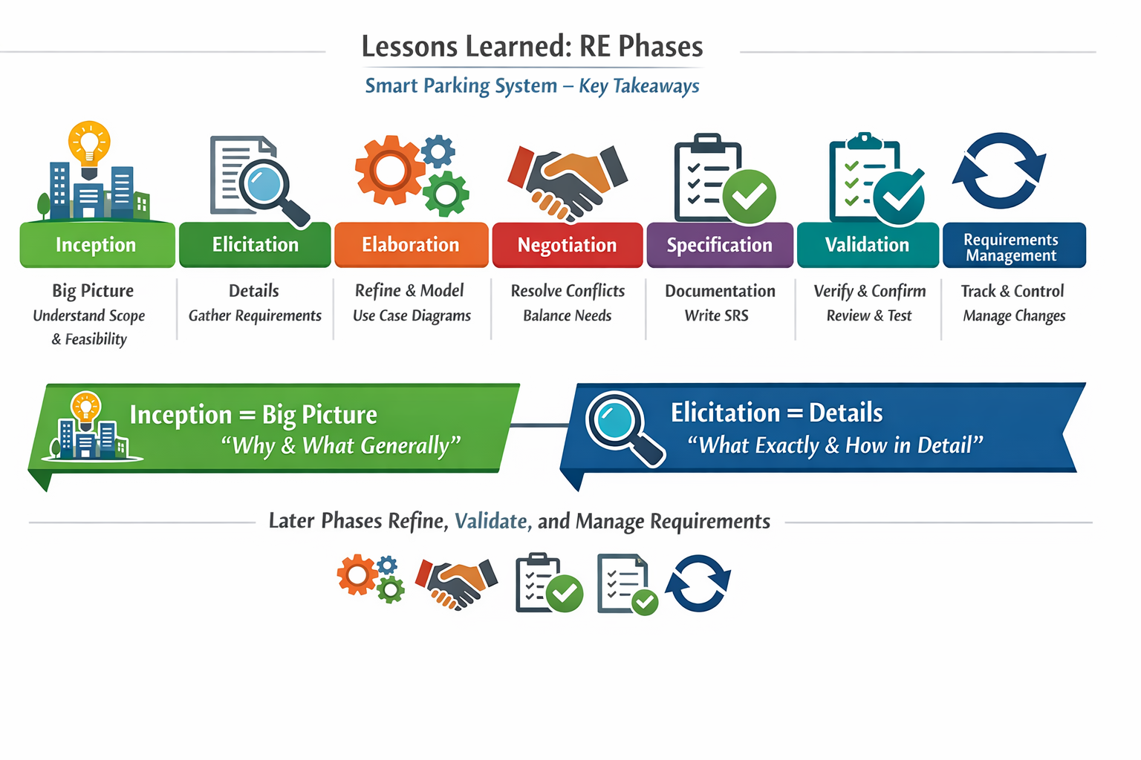
Notes:
Summarize key insights: these phases determine project success or failure. Emphasize the importance of teamwork and documentation.

Slide 87
Mini Project / Class Activity
Choose a simple system:
Identify stakeholders & define inception summary
Apply one elicitation technique (interview/questionnaire)
Document findings
Notes:
This assignment reinforces lecture learning with hands-on practice. Encourage creativity and practical stakeholder engagement.

Slide 88
Goal-Oriented Requirements Engineering (GORE)
Understanding the "Why" behind the System
Ms. Shehla Saeed
Notes:
Welcome to the session. Today, we are shifting our focus from what a system should do, to why it needs to do it.

Slide 89
Learning Objectives
Understand Goal-Oriented Requirements Engineering
Identify goals, tasks, and softgoals
Learn goal modeling techniques
Convert goals into requirements

Slide 90
What is Goal-Oriented RE?
The Paradigm Shift:
Traditional RE focuses on system features ("what the system should do "). GORE focuses on the intentions and rationale (" why it should do it ").
In GORE
Stakeholders’ objectives/goals are identified first
Requirements are derived from these goals
Focus is on why the system is needed
Example:
Goal Improve parking availability in the city
Requirement System should display real-time parking availability.

Slide 91
Why Use Goal Models?
Requirements Elicitation: Helps discover hidden requirements by repeatedly asking "Why?" and "How?".
Traceability: Provides a clear link from high-level business strategy down to low-level technical implementation.
Conflict Resolution: Helps identify conflicting goals early (e.g., "High Security" vs. "Easy to Use") so stakeholders can negotiate trade-offs.
Completeness: Ensures every implemented feature is actually tied to a business need (preventing gold-plating).
Notes:
Keep asking Why until the requirement either collapses… or reveals its true purpose.” annoyingly curious
“Every feature should have a reason to exist—or it’s intellectual clutter.”
Traceability is about connecting the dots from:
Business Goal → Stakeholder Goal → System Requirement → Design → Code

Slide 92
What is a Goal in RE?
Definition: A goal is an objective that the system under consideration should achieve.
Stakeholder intentions are captured as goals
Requirements are derived from these goals
Scope: Goals can range from high-level strategic business objectives (e.g., " Improve parking management ") to low-level technical requirements (e.g., " Detect free parking slots ").

Slide 93
Types of Goals
Hard Goals → measurable → functional behavior Soft Goals → quality attributes → non-functional requirements

Slide 94
Hard Goals → Usually Functional Requirements
A hard goal has clear success criteria.
Examples (Smart Parking System)
Hard Goal Reserve parking space
Derived Functional Requirement System shall allow users to book a parking slot via mobile app.
Hard Goal Display available parking slots
Derived Functional Requirement System shall show real-time parking availability.
These describe system actions, so they become functional requirements.

Slide 95
Soft Goals → Usually Non-Functional Requirements
A soft goal describes quality or performance.
Example
Soft Goal System should be user friendly
Derived Non-Functional Requirement The mobile app should allow users to complete booking within 3 steps.
Soft Goal System should be secure
Derived Non-Functional Requirement All payments must use encrypted transactions.
Soft goals usually relate to qualities like:
Usability, Performance, Reliability,Security,scalability

Slide 96
Goal Refinement/Goal Decomposition
Large goals are broken into smaller goals
Process known as goal decomposition
Helps derive clear system requirements
Example:
Goal Improve parking management
Sub goals
Detect free parking slots
Guide drivers to available slots
Enable online payments
Eventually these goals become system requirements.

Slide 97
Goal Decomposition & Relationships
AND decomposition: all sub-goals required
OR decomposition: any one sub-goal sufficient
Contribution Links (Impacts): Used primarily for softgoals to show how a task affects an objective.
Make (++): Strongly positive impact.
Help (+): Weakly positive impact.
Hurt (-): Weakly negative impact.
Break (--): Strongly negative impact.

Slide 98
AND decomposition
An AND relationship means all sub-goals must be satisfied to achieve the main goal.
If even one sub-goal fails, the main goal fails.
Example – Smart Parking System
Main Goal Enable Online Parking Service
To achieve this, several things must happen.
Parking spaces must be detected
A mobile application must exist
Payment must be processed

Slide 99
OR Decomposition (OR Goal)
An OR relationship means any one sub-goal can achieve the main goal.
Multiple alternative solutions exist.
Example – Parking Reservation
Goal Allow Parking Reservation
There are multiple ways to achieve it.
Drivers can reserve parking by:
Mobile application OR
Parking kiosk machine
Either option satisfies the goal.

Slide 100
Goal Conflicts
Some goals conflict with others
Example: security vs usability
Goal modeling helps analyze trade-offs
Example
Goal 1 Provide strong security
Goal 2 Provide quick access
More security can slow down access.
Goal modeling helps analyze and balance such trade-offs.

Slide 101
Goal Modeling Techniques
While the core concepts remain the same, several frameworks provide specific notations and methodologies:
KAOS (Knowledge Acquisition in automated Specification):
Focuses on formal, mathematically rigorous goal refinement and system behavior.
i* (i-star)
Focuses on actors, their intentions, and social dependencies.
Tropos
Tropos is unique because it takes the goal-oriented, agent-based philosophy and stretches it across the entire software development lifecycle.

Slide 102
The KAOS Framework
Core Philosophy: A systematic, formal approach from high-level goals down to precise object models and state transitions.
Key Elements:
Goal Model: AND/OR graphs of goals.
Responsibility Model: Assigning terminal goals (requirements) to specific agents.
Object Model: The domain entities involved in the goals.
Operation Model: The specific system behaviors that fulfill the requirements.

Slide 103
The i (i-star) Framework*
Core Philosophy: Systems involve social networks of intentional actors who depend on each other.
Strategic Dependency (SD) Model: Shows who depends on whom for what (Goals, Tasks, Resources).
Strategic Rationale (SR) Model: Looks "inside" an actor to show how their internal goals are met and what alternatives exist.
Example: A bank might depend on an IT provider for "System Maintenance," which is broken down into "Regular Updates" and "Security Patches."

Slide 104
The Tropos Methodology
What is Tropos?
An agent-oriented software development methodology tailored for distributed, complex systems.
The i Connection:*
Tropos adopts the i* (i-star) modeling language (Actors, Goals, Tasks, Resources, Dependencies) as its foundational notation.
The Big Differentiator:
Instead of changing modeling languages when moving from requirements to design (e.g., switching from Goal Models to UML Class Diagrams), Tropos uses the exact same agent-oriented concepts from the first stakeholder meeting all the way down to writing the code.

Slide 105
Analyzing and Evaluating Goal Models
Qualitative Evaluation: Using contribution links (+, -, etc.) to evaluate if a softgoal is sufficiently "satisficed" based on chosen design alternatives.
Quantitative Evaluation: Assigning numerical weights and probabilities to goals for mathematical decision-making.
Identifying Obstacles: Modeling anti-goals (things we don't want to happen, like "System hacked") and designing mitigation goals.

Slide 106
Qualitative Evaluation – Satisficing Softgoals
The Challenge:
How do we measure things that don't have hard numbers, like "Security" or "Usability"?
The Concept of "Satisficing":
A term coined by Herbert Simon (Satisfy + Suffice). It means a goal is met to an acceptable degree rather than strictly verified.
Contribution Links: We evaluate alternatives based on how they impact higher-level softgoals using qualitative labels:
Make (++): Task guarantees the goal is satisficed.
Help (+): Task partially contributes to the goal.
Hurt (-): Task partially prevents the goal.
Break (--): Task completely denies the goal.
Bottom-Up Propagation: We start at the bottom of the graph (the concrete tasks) and propagate these labels upwards.
If a task "Helps" Usability but "Hurts" Security, stakeholders can visually see the trade-off and make a judgment call.

Slide 107
Quantitative Evaluation – Doing the Math
The Challenge:
Sometimes qualitative labels are too vague. When deciding between a $100k system architecture and a $500k one, stakeholders want numbers.
Assigning Weights: Higher-level goals are assigned numerical weights based on priority (e.g., Security = 0.7, Performance = 0.3).
Assigning Scores/Probabilities: Alternative tasks or system designs are given scores based on how well they fulfill the goals (e.g., Task A has a 90% probability of meeting the Performance goal, but only 40% for Security).
Utility Functions: By multiplying the weights by the scores and summing them up, you can calculate a final "Utility Score" for different design alternatives.
The Result: The team simply chooses the architectural alternative that yields the highest overall mathematical score.

Slide 108
Obstacle Analysis – Expecting the Unexpected
What is an Obstacle?
A precondition or event that prevents a goal from being achieved. (e.g., Goal: "User is Authenticated." Obstacle: "User forgot password" or "Server is down").
Why Model Them?
System failures rarely happen because of what the system does; they happen because of what the system failed to anticipate. KAOS is specifically famous for rigorous obstacle analysis.
The Process:
Identify Obstacles: Take every terminal goal and ask, "How could this fail?" (Often done using fault-tree analysis).
Assess Impact: Is this a minor annoyance or a critical failure?
Generate Resolutions: We alter the goal model to handle the obstacle.

Slide 109
Example Scenario
Smart Parking System
Drivers waste time searching for parking
Goal: Reduce parking search time

Slide 110
High-Level Goal
Improve Urban Parking Management

Slide 111
Sub Goals
Detect parking availability
Provide mobile application
Enable parking reservation
Enable digital payment

Slide 112
Tasks
Install sensors
Develop mobile application
Integrate payment gateway

Slide 113
Goal to Requirement Example
Goal: Provide parking information
Requirement: System shall display real-time parking availability

Slide 114
Terminologies used in Goal Models
Goals (Optional Goals, Mandatory Goals)
Tasks and Plans
AND / OR decomposition
Precedence Links( +ive and –ive)

Slide 115
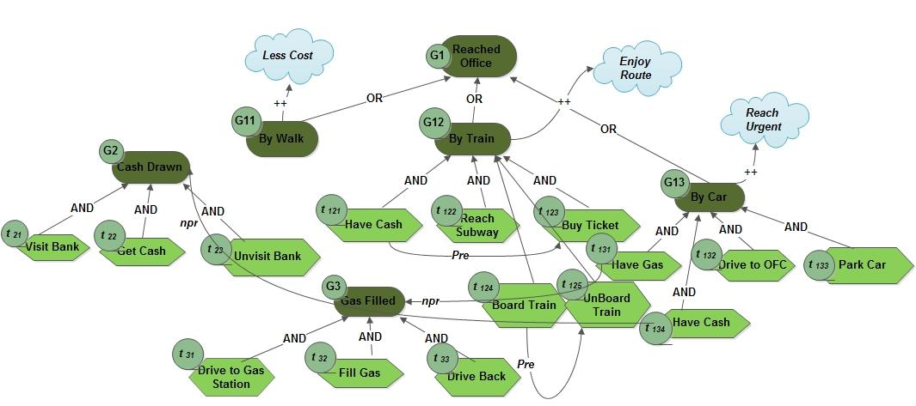


Slide 116
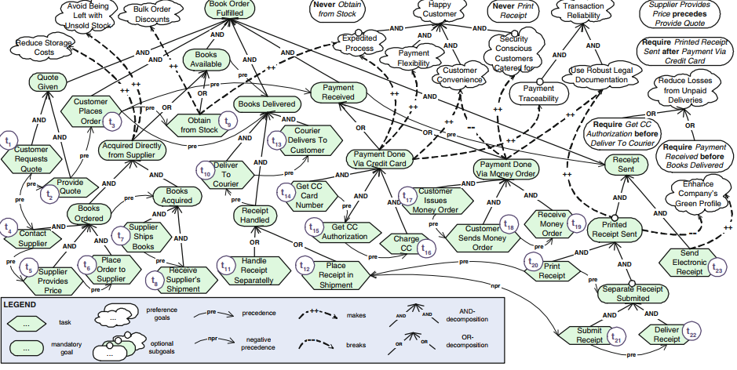

Slide 117
+ve Precedence
User Authentication → Reserve Parking Slot
Explanation
User must log in first
Then they can reserve parking
If authentication fails → reservation cannot proceed.

Slide 118
-ve Precedence
A negative precedence means one action or goal must NOT happen before another, or one condition prevents another.
Think of it as:
“This should not occur unless something else has happened” or “If this happens, that must NOT happen”
Example – Smart Parking SystemPayment
Payment Failed ⟶ NOT Confirm Booking
Explanation
If payment fails
System must prevent booking confirmation
This is a safety constraint.

Slide 119
Summary
GORE focuses on stakeholder intentions
Goals are refined into requirements
Goal models support better system design

